Slide 1


Foundations of
Scientific Computing
(SciComp 101)
Dave Biersach
dbiersach@bnl.gov
Session 09 Measuring Waves

Slide 2
Session 09 – Goals
Review the critical parts of a sinusoidal transverse wave, including amplitude, wavelength, and frequency
Establish the relationship between sampling frequency and measurement aliasing and appreciate the Nyquist Sampling Theorem
Consider the kinematics of a traveling wave as it relates to wave number and angular velocity, and understand how superposition can lead to standing waves
Correlate the decline of radial sector density as a function of distance from the center of a circle and how this affects the fair (uniform) random sampling of points within a circle

Slide 3
Most of Science is Waves
Biology
Chemistry
Physics
Math
Electrical
Magnetic
Acoustic
Heat Flow
Vibrational
Torsional
Nuclear / Quantum
Gravitational
Oceanic / Tidal
Orbital Precession
Springs
Pendulums
Tomography
Stock Market
Economics
Astronomical
Fluid Dynamics
Earthquakes
AC / DC
AM / FM
Speech
Heartbeats
It is important that you develop a keen
understanding of the mathematics of waves!

Slide 4
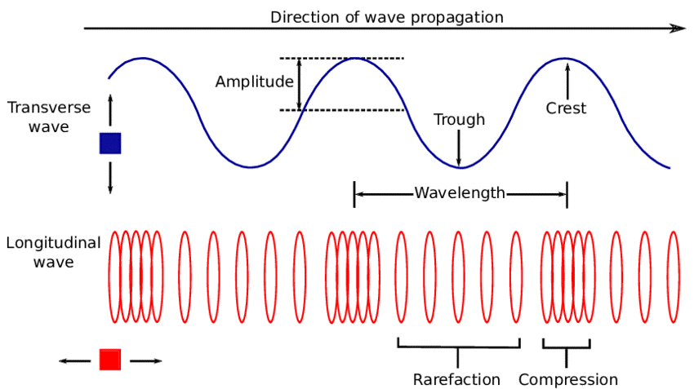
Wave Types

Slide 5
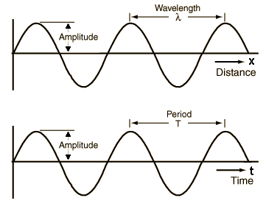
Transverse Wave Components
Wavelength is across distance
Period
is across time

Slide 6
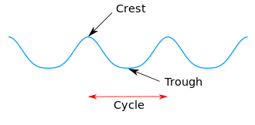


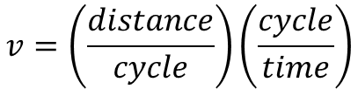



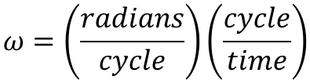




Transverse Wave Components
$$2π=\frac{radians}{cycle}$$
$$Angular velocity=ω=\frac{radians}{time}$$
$$ω=\left(\frac{radians}{cycle}\right)\left(\frac{cycle}{time}\right)$$
$$Period=T=\frac{time}{cycle}$$
$$ω=2πf$$
$$Frequency=f=\frac{cycle}{time}=\frac{1}{T}$$
$$Wave velocity=v=\frac{distance}{time}$$
$$Wavelength=λ=\frac{distance}{cycle}$$
$$v=\left(\frac{distance}{cycle}\right)\left(\frac{cycle}{time}\right)$$
$$Wavenumber=k=\frac{2π}{λ}$$
$$v=λf$$

Slide 7
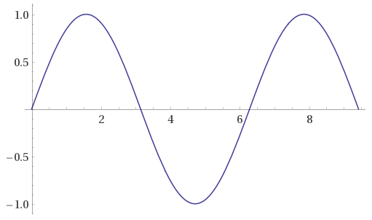

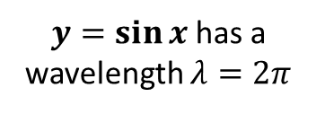






Transverse Wave Components
$$y=\sin{x}$$
$$2π$$
$y=\sin{x}$ has a wavelength $λ=2π$
$$\frac{π}{2}$$
$$\frac{π}{2}+2π$$
$$sin\left(\frac{π}{2}\right){=1}$$
$$2π$$
Crest to Crest
1
0
$$\sin\left(\frac{π}{2}+2π\right)=\sin{\frac{π}{2}\cos{2π+\cos{\frac{π}{2}\sin{2π}}}=1}$$

Slide 8
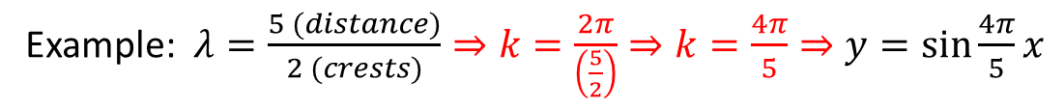
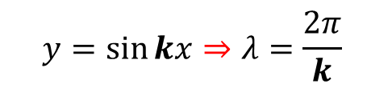

Transverse Wave Components
$y=\sin{x}$ has a wavelength $λ=2π$
if k = 1
$$Wavenumber=k=\frac{2π}{λ}$$
$$y=\sin{kx}⇒λ=\frac{2π}{k}$$
Example: $λ=\frac{5 (distance)}{2 (crests)}⇒k=\frac{2π}{\left(\frac{5}{2}\right)}⇒k=\frac{4π}{5}⇒y=\sin{\frac{4π}{5}x}$

Slide 9
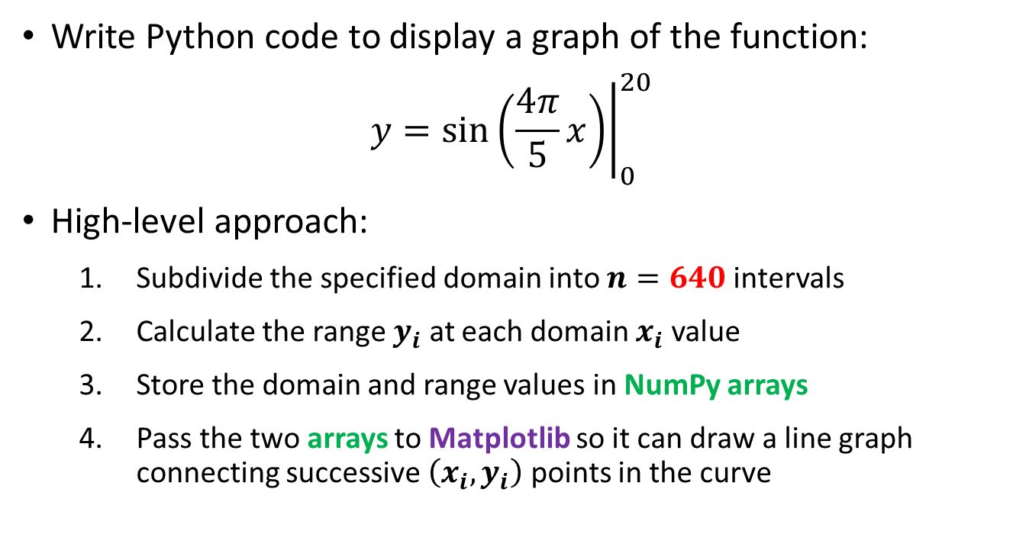
Known Wave Aliasing
Write Python code to display a graph of the function:
$$y={\left.\sin\left(\frac{4π}{5}x\right)\right|}_{0}^{20}$$
High-level approach:
Subdivide the specified domain into $n=640$ intervals
Calculate the range $y_{i}$ at each domain $x_{i}$ value
Store the domain and range values in NumPy arrays
Pass the two arrays to Matplotlib so it can draw a line graph connecting successive $\left(x_{i},y_{i}\right)$ points in the curve
2 crests per every 5 lengths

Slide 10
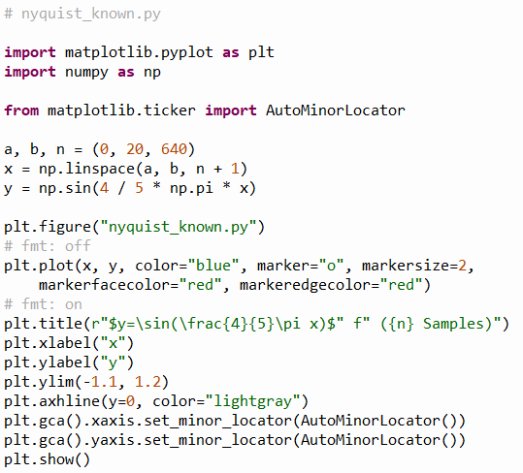

Open nyquist_known.py
①
②
③
④
⑤
⑥
⑦
⑧
⑨
⑩

Slide 11
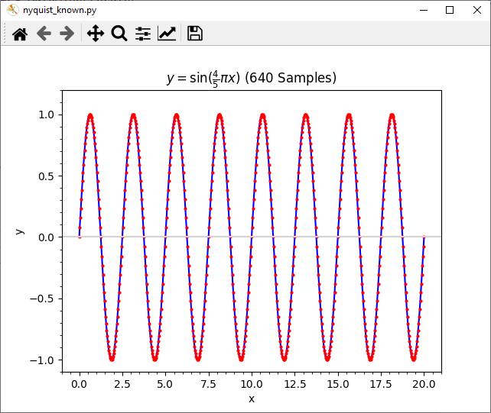

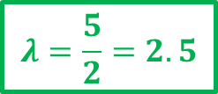

Run nyquist_known.py
$$y={\left.\sin\left(\frac{4π}{5}x\right)\right|}_{0}^{20}$$
$$\frac{20}{λ}=8 crests$$
$$λ=\frac{5}{2}=2.5$$

Slide 12


https://www.latex-project.org

Slide 13

https://www.overleaf.com

Slide 14
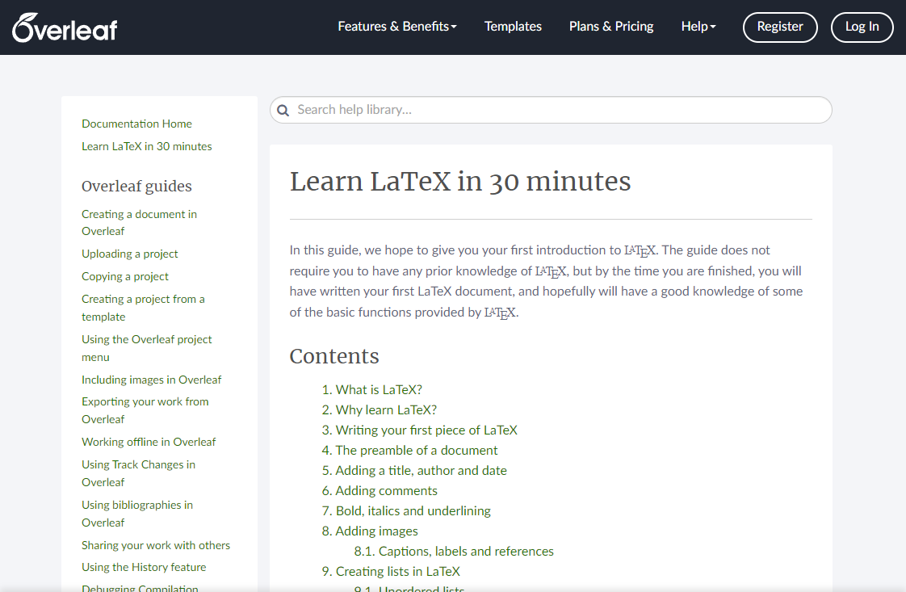
https://www.overleaf.com/learn/latex/Learn_LaTeX_in_30_minutes

Slide 15

https://www.texstudio.org
100% free – runs on Windows, Mac, Linux

Slide 16
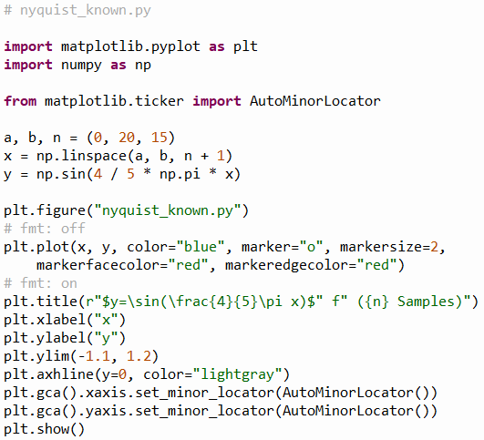
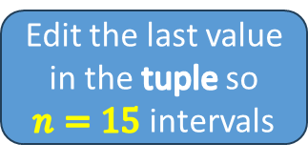
Edit nyquist_known.py
①
Edit the last value in the tuple so $n=15$ intervals

Slide 17
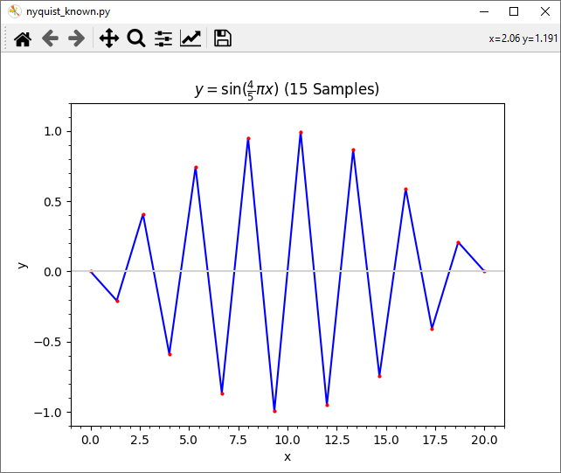
Run nyquist_known.py

Slide 18

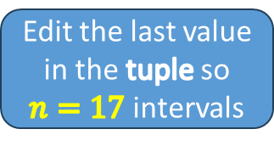
Edit nyquist_known.py
①
Edit the last value in the tuple so $n=17$ intervals

Slide 19
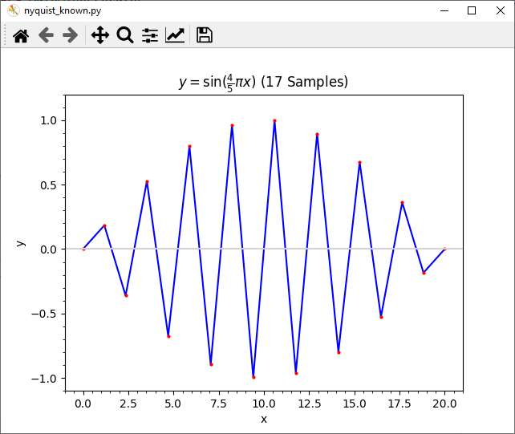
Run nyquist_known.py

Slide 20

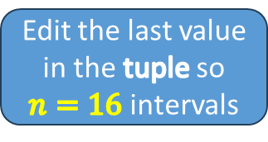
Edit nyquist_known.py
①
Edit the last value in the tuple so $n=16$ intervals

Slide 21
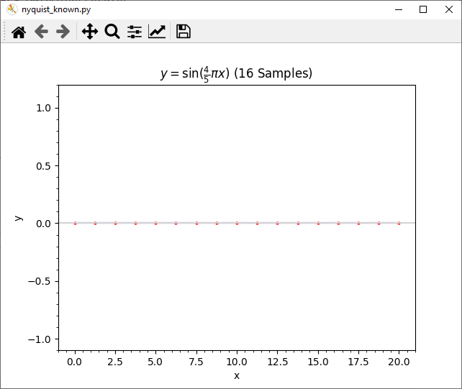
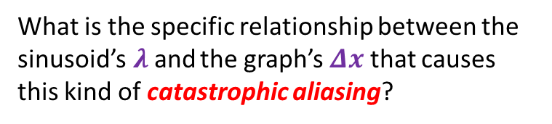
Run nyquist_known.py
What is the specific relationship between the sinusoid’s$λ$and the graph’s $Δx$ that causes this kind of catastrophic aliasing?

Slide 22


Edit nyquist_known.py
①
Edit the last value in the tuple so $n=31$ intervals

Slide 23
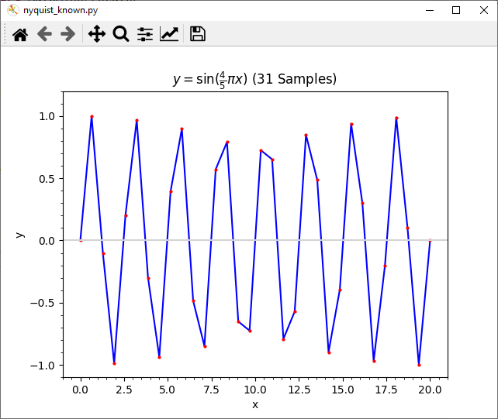
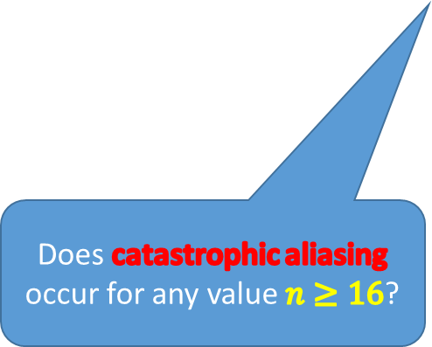
Run nyquist_known.py
Does catastrophic aliasing occur for any value $n≥16$?

Slide 24


Edit nyquist_known.py
①
Edit the last value in the tuple so $n=33$ intervals

Slide 25
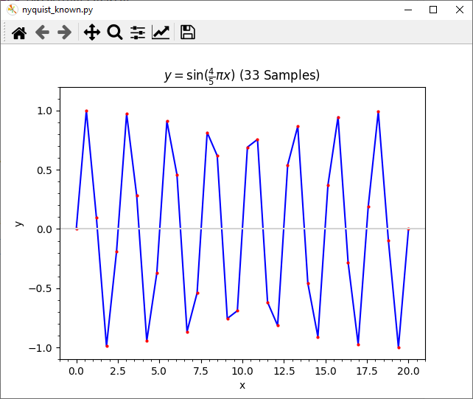
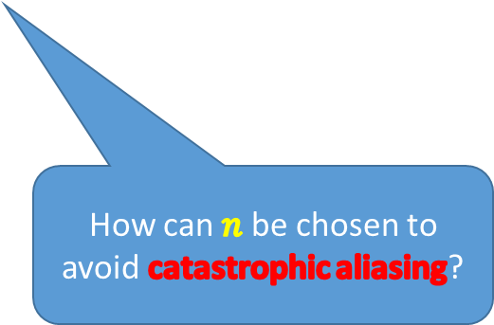
Run nyquist_known.py
How can $n$ be chosen to avoid catastrophic aliasing?

Slide 26


Edit nyquist_known.py
①
Edit the last value in the tuple so $n=32$ intervals

Slide 27
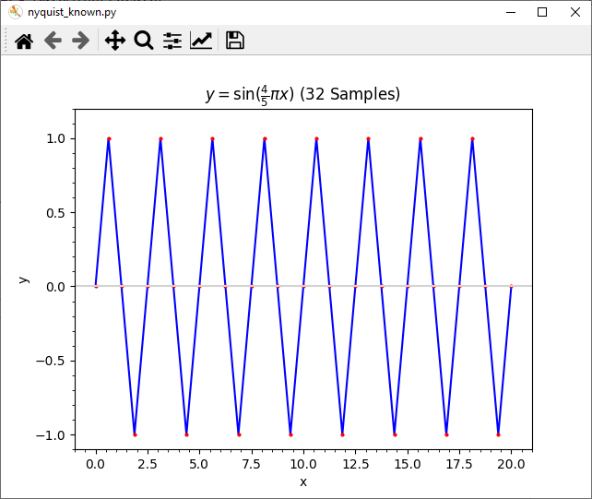
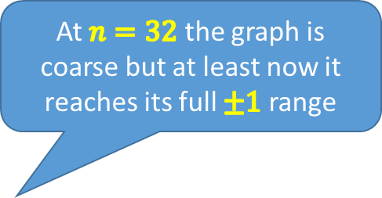
Run nyquist_known.py
At $n=32$ the graph is coarse but at least now it reaches its full $±1$ range

Slide 28
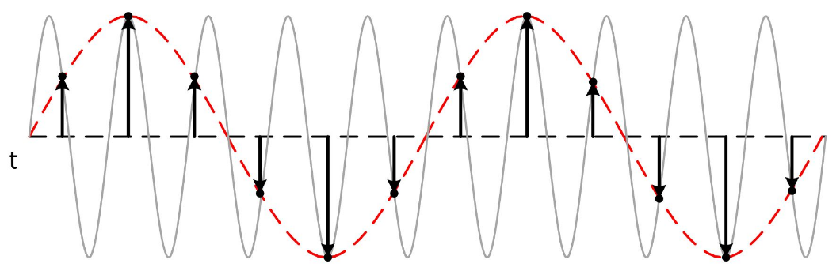

Nyquist Sampling Theorem
To minimize aliasing (data loss), if you know $λ$ ahead of time, set $n=\left(\frac{2}{λ}\right)\left(b−a\right)\left(2r\right), where r∈ℤ^{+}$
This rule is the Nyquist Sampling Theorem
You need at least 2x as many samples as the highest frequency you intend to capture
The grey wave is under-sampled (n is too low!)

Slide 29
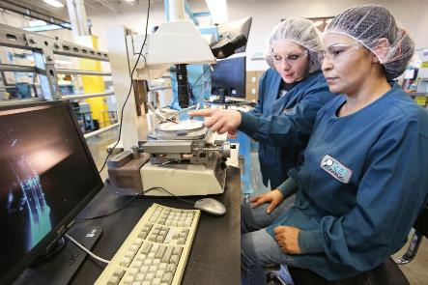
Unknown Wave Aliasing
You have an experiment that exhibits a periodic behavior having a theoretical frequency of 210 Hz
Therefore, to meet the Nyquist minimum, you should take at least 420 samples/sec to capture its wavelike nature

Slide 30
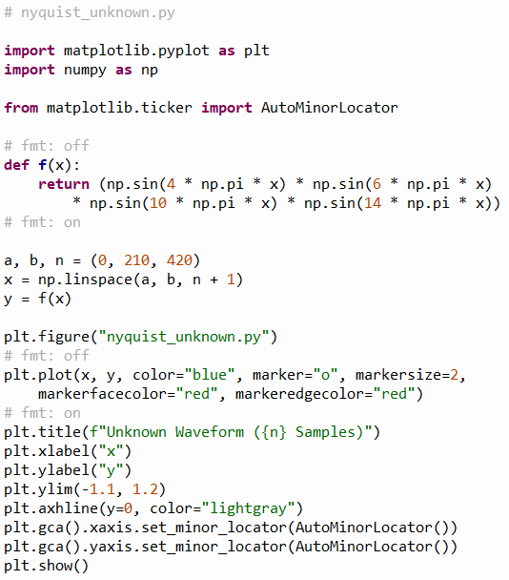
Open nyquist_unknown.py
①

Slide 31
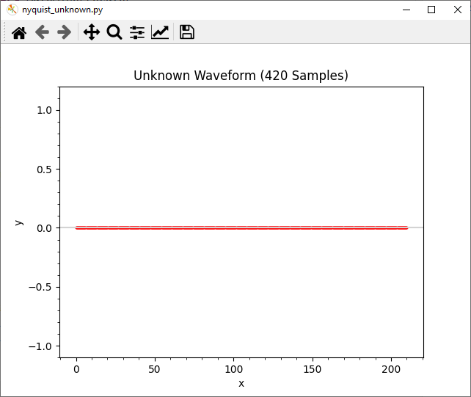
Run nyquist_unknown.py

Slide 32


Nyquist Sampling Theorem
Enough! We will take 14x more samples!

Slide 33

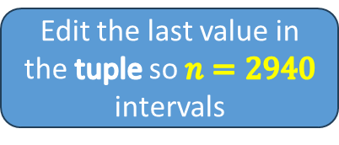
Edit nyquist_unknown.py
①
Edit the last value in the tuple so $n=2940$ intervals

Slide 34
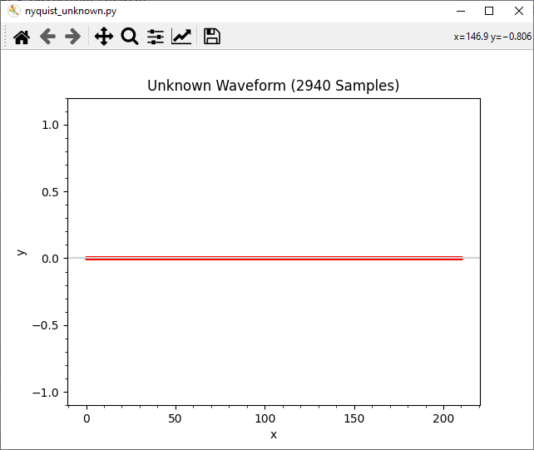
Run nyquist_unknown.py

Slide 35

Nyquist Sampling Theorem
What if we take one less sample?

Slide 36
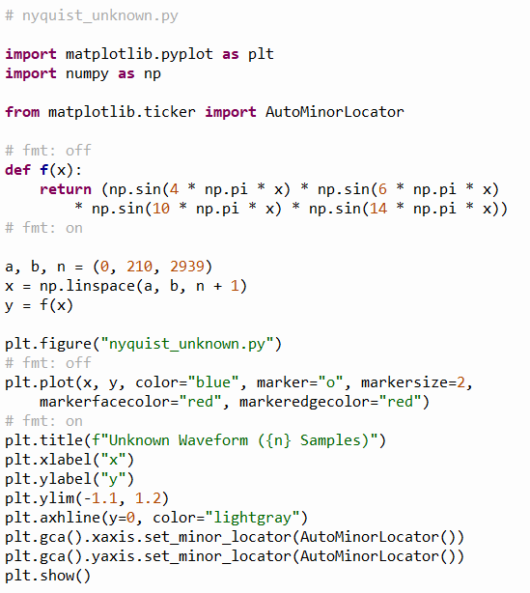

Edit nyquist_unknown.py
①
Edit the last value in the tuple so $n=2939$ intervals

Slide 37
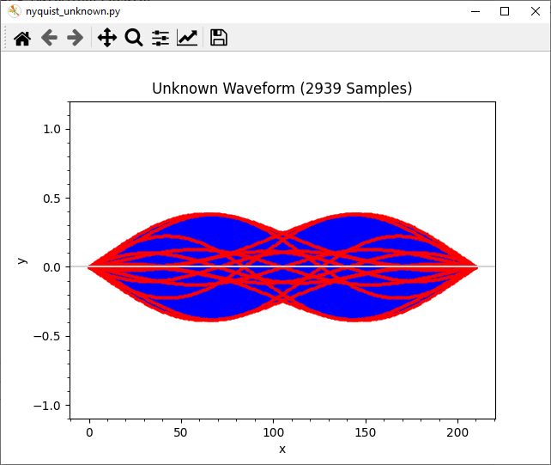
Run nyquist_unknown.py
Taking one less sample made all the difference – why?
Now we can finally see the wave in its true form

Slide 38
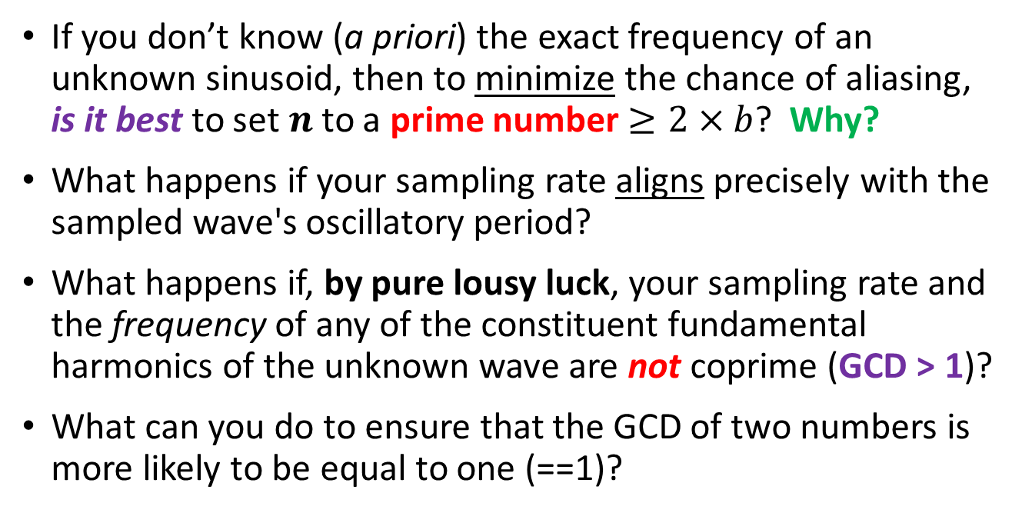
Nyquist Sampling Theorem
If you don’t know (a priori) the exact frequency of an unknown sinusoid, then to minimize the chance of aliasing, is it best to set $n$ to a prime number $≥2×b$? Why?
What happens if your sampling rate aligns precisely with the sampled wave's oscillatory period?
What happens if, by pure lousy luck, your sampling rate and the frequency of any of the constituent fundamental harmonics of the unknown wave are not coprime (GCD > 1)?
What can you do to ensure that the GCD of two numbers is more likely to be equal to one (==1)?

Slide 39

Run nyquist_unknown.py
$$y=\sin\left(4πx\right)\sin\left(6πx\right)\sin\left(10πx\right)sin⁡(14πx)$$
Using a large prime number of samples helps avoid accidental aliasing if you don’t yet know the true nature of the underlying waveform

Slide 40
Traveling Waves & Superposition
$$λ=\frac{2π}{k}→k=\frac{2π}{λ}$$
$$y_{1}=A_{1}\sin\left(k_{1}x+ω_{1}t\right)$$
These waves have both spatial and temporal components
$$y_{2}=A_{2}\sin\left(k_{2}x+ω_{2}t\right)$$
$$f=\frac{ω}{2π}→ω=2πf$$
$$y_{1}+y_{2}= ?$$
$$y_{1}=A_{1}\sin\left(k_{1}x+ω_{1}t\right)=A_{1}\sin{k_{1}x}\cos{ω_{1}t}+A_{1}\cos{k_{1}x}\sin{ω_{1}t}$$
Angle Sum Identity
$$y_{2}=A_{2}\sin\left(k_{2}x+ω_{2}t\right)=A_{2}\sin{k_{2}x}\cos{ω_{2}t}+A_{2}\cos{k_{2}x}\sin{ω_{2}t}$$
Simple Case: $A_{1}=A_{2}=1,ω_{1}=ω_{2}=0$
1
$$y_{1}=\sin{k_{1}x}\cos{0t}+\cos{k_{1}x}\sin{0t}$$
1
$$y_{2}=\sin{k_{2}x}\cos{0t}+\cos{k_{2}x}\sin{0t}$$
$$y_{1}+y_{2}=\sin{k_{1}x}+\sin{k_{2}x}=2\sin\left(\frac{\left(k_{1}+k_{2}\right)x}{2}\right)\cos\left(\frac{\left(k_{1}−k_{2}\right)x}{2}\right)$$
SUM
PRODUCT

Slide 41
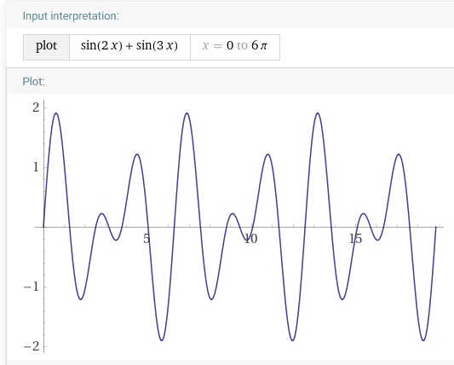
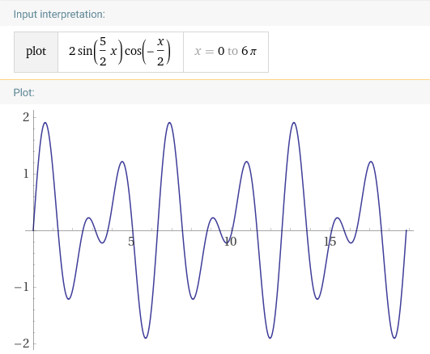
Travelling Waves & Superposition
But what if the two waves are oscillating at different angular velocities or have different amplitudes, or different wave numbers?

Slide 42
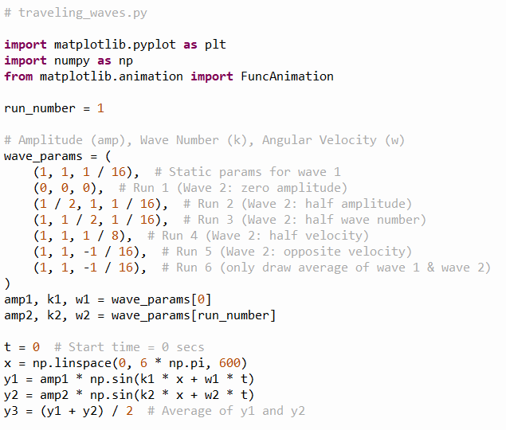
Open traveling_waves.py
①
②
③
④
⑤
⑥
⑦
⑧
⑨
⑩

Slide 43
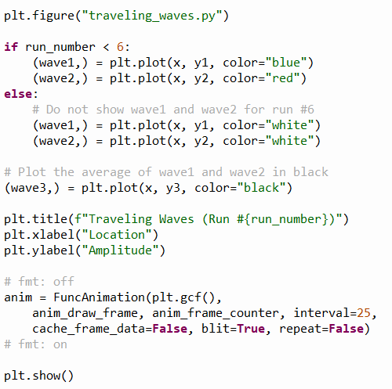
View traveling_waves.py
①
②
③
④
⑤
⑥
⑦
⑧

Slide 44
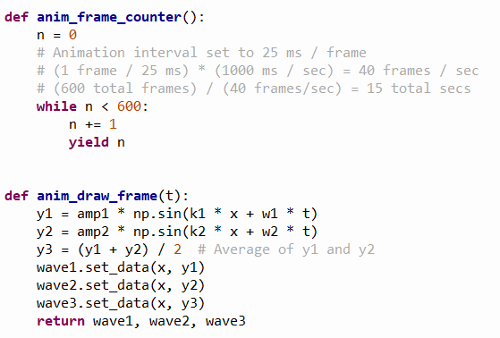
View traveling_waves.py
①
②
③
④
⑤
⑥
⑦
⑧
⑨
⑩

Slide 45
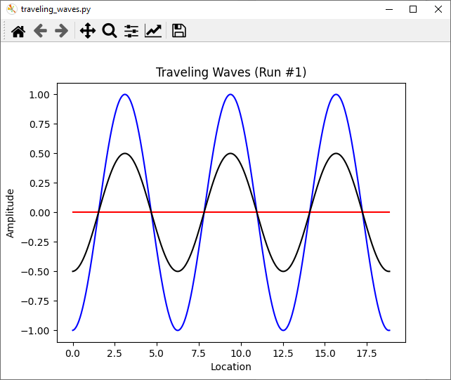
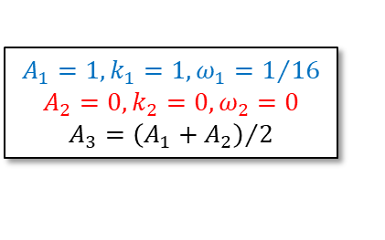
Run traveling_waves.py
$$A_{1}=1, k_{1}=1, ω_{1}=1/{16}$$
$$A_{2}=0, k_{2}=0, ω_{2}=0$$
$$A_{3}={\left(A_{1}+A_{2}\right)}/2$$

Slide 46
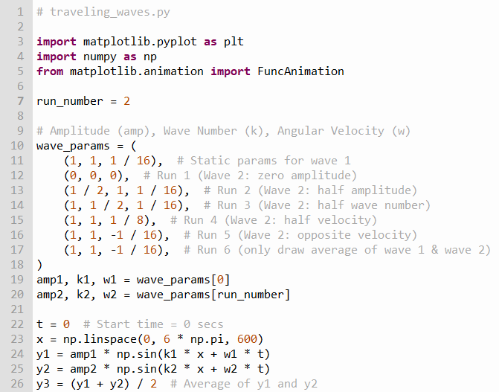
Edit traveling_waves.py
①

Slide 47
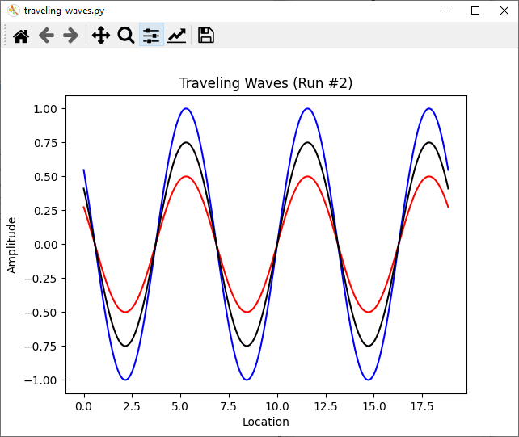
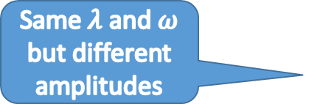

Run traveling_waves.py
$$A_{1}=1, k_{1}=1, ω_{1}=1/{16}$$
$$A_{2}=1/2, k_{2}=1, ω_{2}=1/{16}$$
$$A_{3}={\left(A_{1}+A_{2}\right)}/2$$
Same $λ$ and $ω$ but different amplitudes

Slide 48

Edit traveling_waves.py
①

Slide 49



Run traveling_waves.py
$$A_{1}=1, k_{1}=1, ω_{1}=1/{16}$$
$$A_{2}=1, k_{2}=1/2, ω_{2}=1/{16}$$
$$A_{3}={\left(A_{1}+A_{2}\right)}/2$$
Different $λ$ but same $ω$and amplitudes

Slide 50

Edit traveling_waves.py
①

Slide 51



Run traveling_waves.py
$$A_{1}=1, k_{1}=1, ω_{1}=1/{16}$$
$$A_{2}=1, k_{2}=1, ω_{2}=1/8$$
$$A_{3}={\left(A_{1}+A_{2}\right)}/2$$
Same amplitudes and $λ$ but different $ω$

Slide 52

Edit traveling_waves.py
①

Slide 53



Run traveling_waves.py
$$A_{1}=1, k_{1}=1, ω_{1}=1/{16}$$
$$A_{2}=1, k_{2}=1, ω_{2}={−1}/{16}$$
$$A_{3}={\left(A_{1}+A_{2}\right)}/2$$
Same $λ$ and amplitudes but opposite $ω$

Slide 54

Edit traveling_waves.py
①

Slide 55


Run traveling_waves.py
The superposition of two waves, each having the
same amplitude and $λ$
but with an opposite $ω$,
produces a standing wave
$$A_{1}=1, k_{1}=1, ω_{1}=1/{16}$$
$$A_{2}=1, k_{2}=1, ω_{2}={−1}/{16}$$
$$A_{3}={\left(A_{1}+A_{2}\right)}/2$$
What points are at the center of these circles?

Slide 56

Uniform (Fair) Sampling in a Circle
Suppose we want to generate random points known to be inside a unit circle centered at the origin
Instead of picking random Cartesian coordinates $\left(x,y\right)$ for the sample points, we could use polar coordinates $\left(r,θ\right)$
We could pick a random radius$\left(0≤r<1\right)$ for each small radian angle $\left(0≤θ<2π\right)$ and then convert those polar coordinates to Cartesian coordinates
Using this approach, we would never waste time picking random dots that fall outside of the circle which might happen if we picked random $\left(x,y\right)$ pairs of Cartesian coordinates
However, we must still ensure the random sample points are distributed uniformly throughout the circle to ensure a fair coverage of the entire sample area

Slide 57

Open circle_sampling.py
①
②
③
④
⑤
⑥
⑦

Slide 58

Run circle_sampling.py
What must we do to sample fairly?
What went wrong with our math?

Slide 59



Uniform (Fair) Sampling in a Circle
https://apps.dtic.mil/sti/pdfs/ADA626479.pdf
$$A=πr^{2}$$
Therefore, to equalize the density of each sector, we need to take the square root of each random radius value
The radial area of each sector is growing by a factor of $r^{2}$ as you move away from the origin (0,0)

Slide 60

Edit sampling_circle.py
①

Slide 61

Run circle_sampling.py
We are now sampling the circle using a uniform (fair) distribution

Slide 62

Session 09 – Now You Know…
Nyquist Sampling Theorem – to minimize aliasing (data loss):
Known wave (you know $λ$) set $n=\frac{b}{λ}r, where r∈ℤ^{+}and r≥2$
That you need at least 2x as many samples as the highest frequency you want to capture is the essence of the Nyquist Theorem
With an unknown wave (you don’t know $λ$) take a prime number of samples $\left(≥2×b\right)$ to minimize the chance of aliasing
The superposition of two traveling waves, having the same wavelength but opposite angular velocity, produces a standing wave
A standing wave still oscillates but does not travel (the location of the nodes remains constant)
Superposition is a crucial concept in physics!

Slide 63

Task 09
Update the Python file named werner_formula.py to show on one graph the following four functions:
$f_{1}\left(x\right)=\sin\left(0.8x\right)$
$f_{2}\left(x\right)=\sin\left(0.5x\right)$
$f_{3}\left(x\right)=f_{1}\left(x\right)∗f_{2}\left(x\right)$
$f_{4}\left(x\right)=$ Werner's Product-to-sum formula for $f_{1}\left(x\right)∗f_{2}\left(x\right)$
Use the domain $−3π≤x≤3π$ subdivided into 100 equally spaced intervals
Plot $f_{4}\left(x\right)$ as a grey dotted line with closed circle markers
Display the legend labels for each curve

